Slide 1
Music Genre Classification:
A Statistical Analysis of Music
Our Music Playlists
Search
Home
Library
By Brandon Rasgaitis, Julien Toulon, Lucie Gaye, and Tyler Desharnais

Slide 2
Introduction:
What is Music Genre Classification?
Why is it important?
Music Genre Classification (MGC): | An example of using Deep Learning to analyze audio signals such as spectrograms, and wave-files in order to determine the genre of a song using a CNN.
Issues with current MGC projects: | Lack of nuance in determining the genre of songs. No statistical data provided on the structure of a song in other MGC projects. No way to determine a song’s commercial success for artists.
Results of our MGC project: | Our project uses the structural data of a song provided by wave files and spectrograms to predict a song’s commercial success, and more accurately classify its genre.

Slide 3
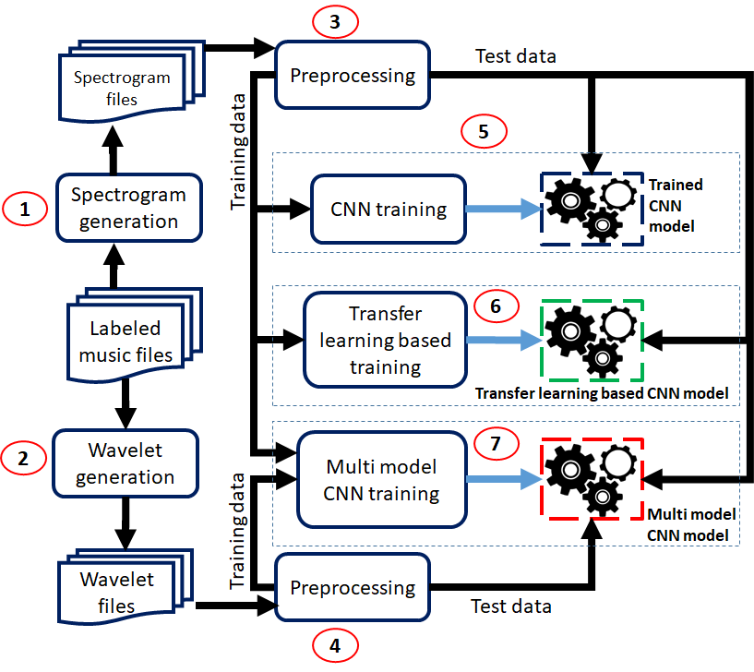
How MGC works:

Slide 4
Data Collection:
01
02
03
04
Mp3 files:
Data:
Our data consists of MP3 audio files collected through spotify developer API, as well as image files of each songs spectrogram
About 20,000 songs and their features are saved into a CSV file, which is the training data for our model.
Preprocessing:
Dataset Manipulation:
In order to provide data analysis, custom made scripts were imported
The ‘final_dataframe.csv’ had to be manipulated by dropping duplicate entries, and changing the dtypes of the dataframe. Additionally, we needed to create features.

Slide 5
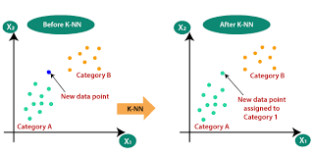
Methodology
Jupityr Notebook, python, google colab
K-nearest neighbors algorithm
For regression and classification
Need to extract features from audio files
Spectograms, MFCC, etc.
first we divide these signals into smaller frames.
Identify different frequencies present in each frame
separate linguistic frequencies from the noise
Take the discrete cosine transform (DCT) of these frequencies

Slide 6
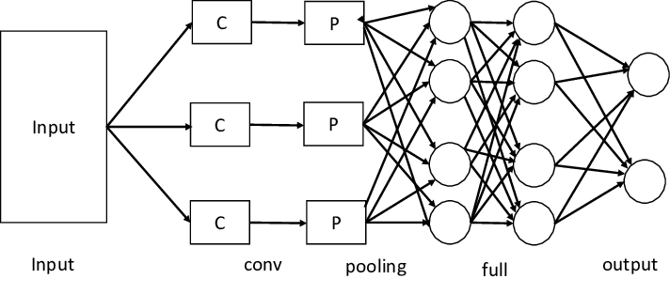
Methodology
Search
CNN-LTSM Model
The CNN model will be used for the extraction of the mel spectrograms.
LTSM is used to handles time sensitive data, such as the length time in a song
Home
Library

Slide 7
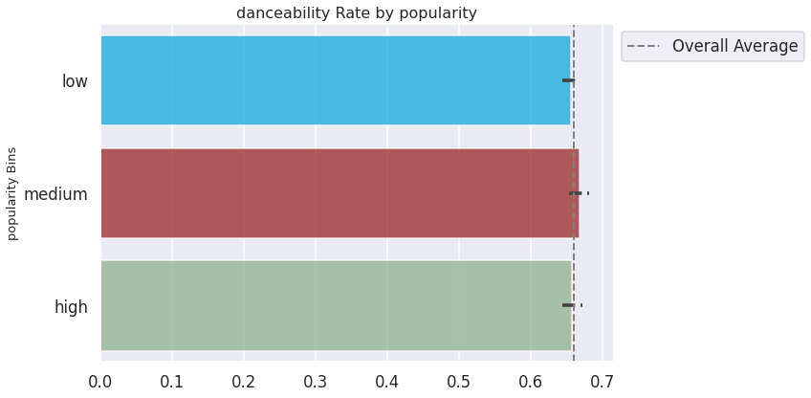
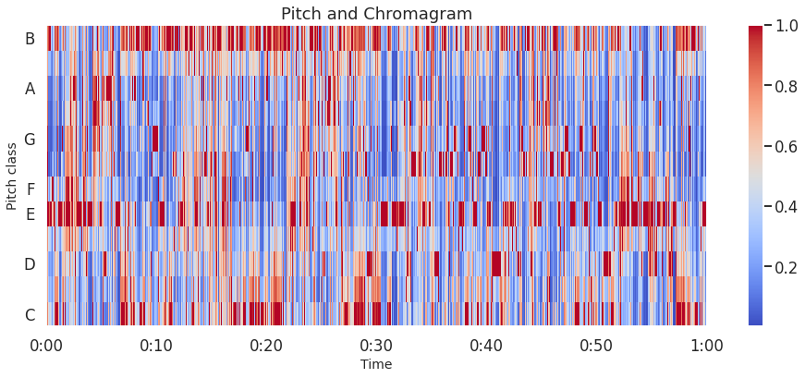
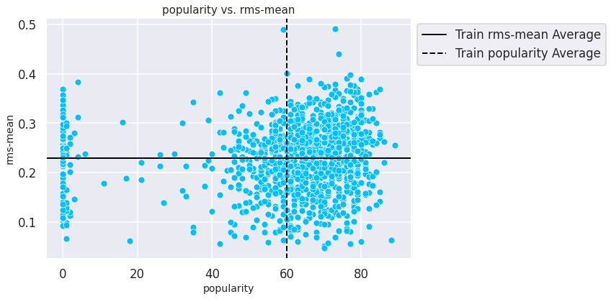
Methodology results:

Slide 8
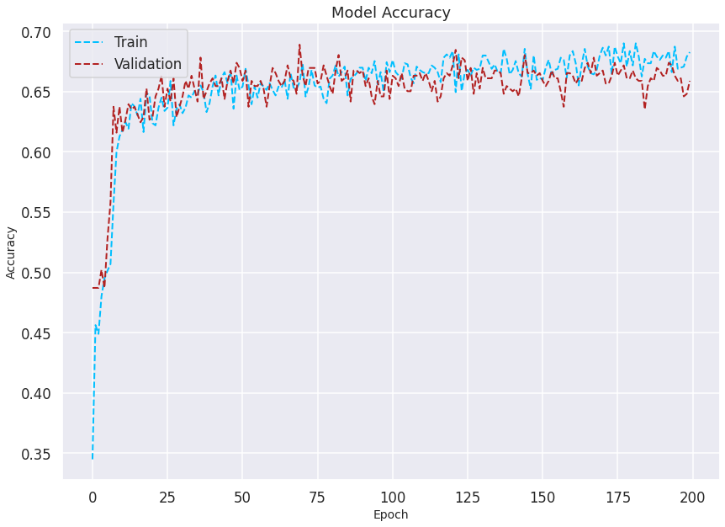
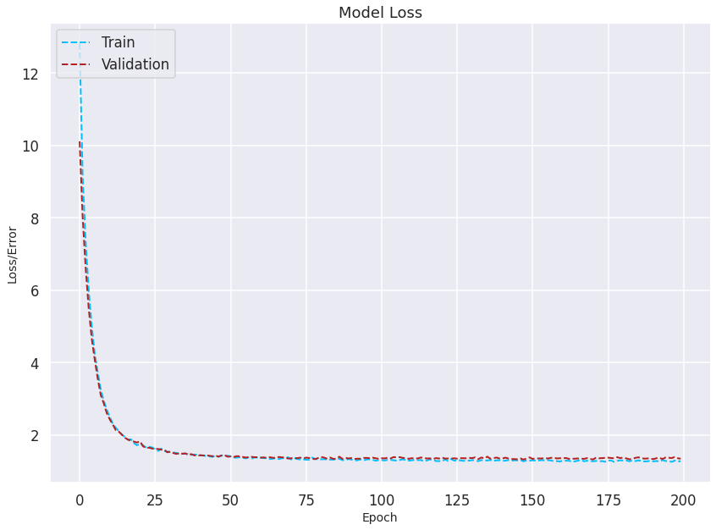
Experiments: Testing different Models
Linear:

Slide 9
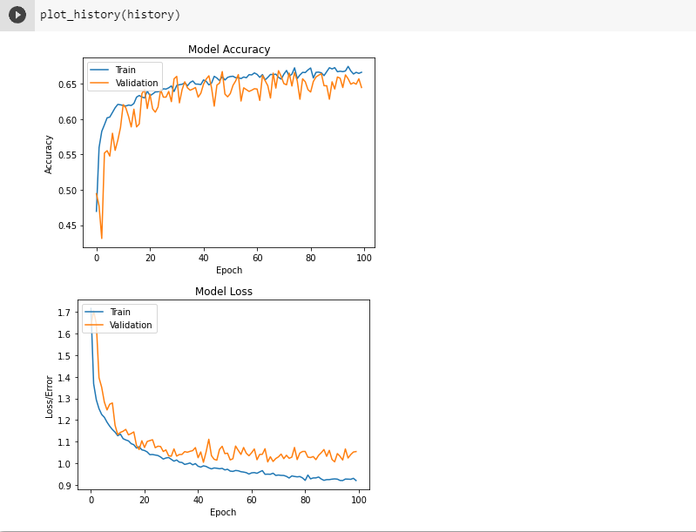
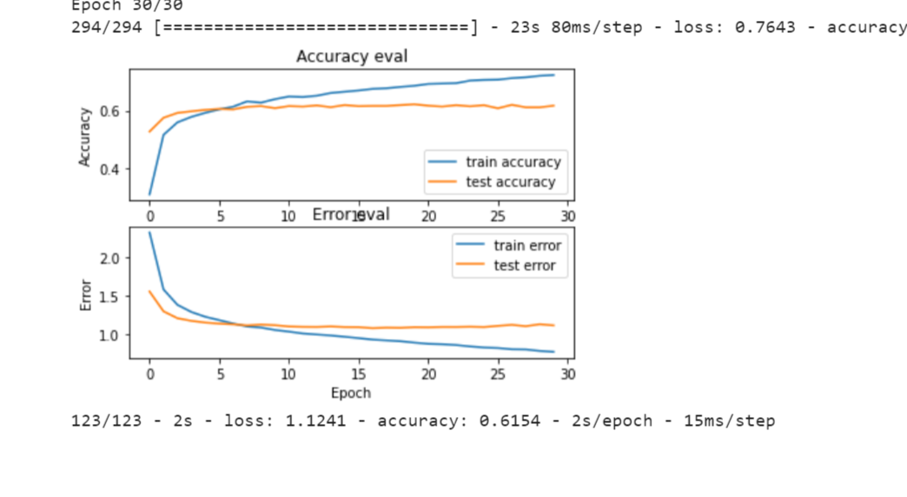
Experiments: Testing different Models
CNN:

Slide 10
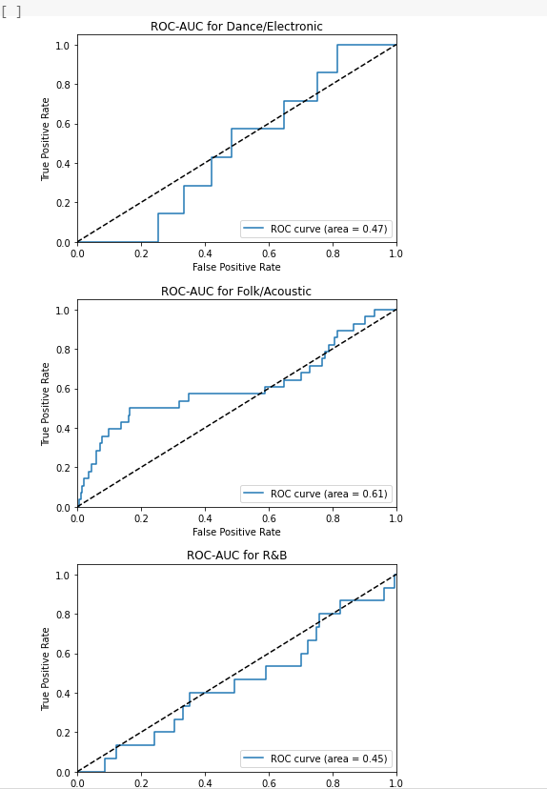
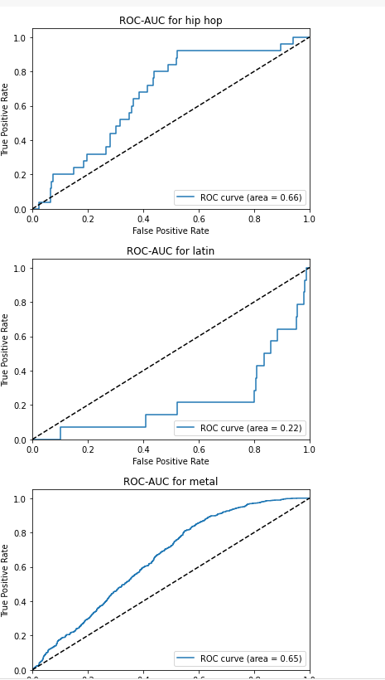
Experiments: CNN

Slide 11
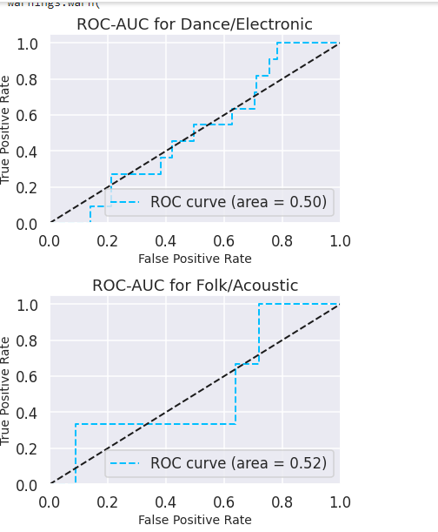
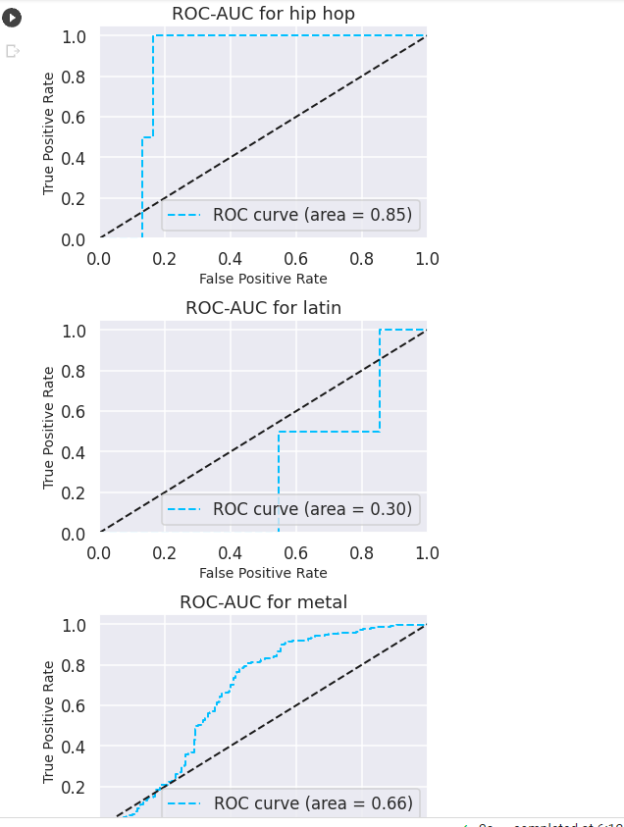
Experiments: Classical MLP

Slide 12
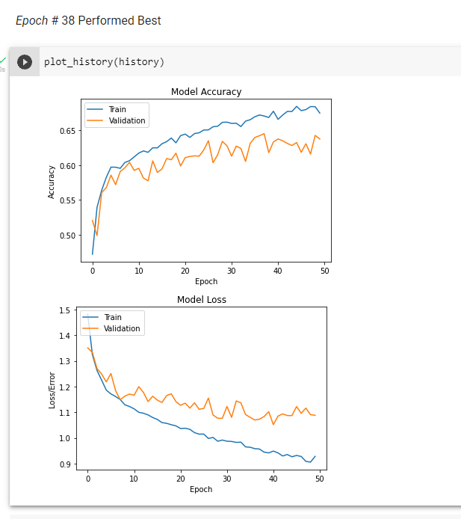
Experiments: LSTM

Slide 13
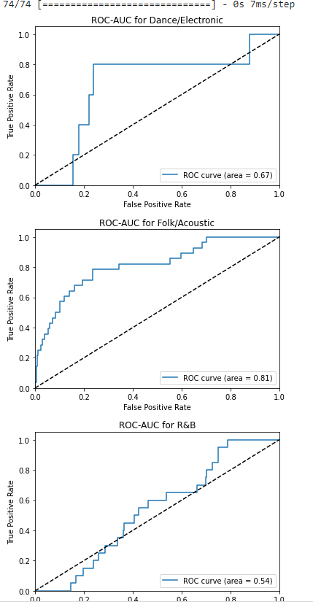
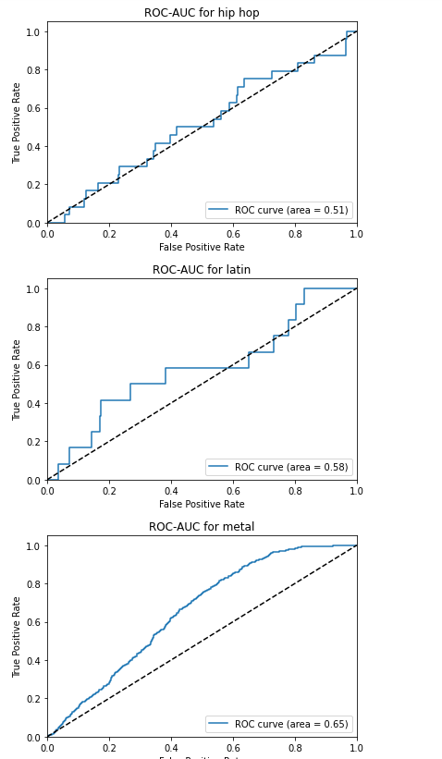
Experiments: LSTM

Slide 14
Experiments: Hyperparameters, etc
Kernel_regulaizer:
Gaussian Noise:
We apply kernel_regularizer to penalize the weights which are very large causing the network to overfit, after applying kernel_regularizer the weights will become smaller.
Adding noise during training can make the training process more robust and reduce generalization error and overfitting. Noise is added to the inputs, but can also be added to weights, gradients, and activation functions.
activity_regulizer:
Loss function:
The value returned gets divided by the input batch size so that the relative weighting between the weight regularizers and the activity regularizers does not change with the batch size.
‘Sparse_categorical_crossentropy’
Used because each feature for our MGC are mutually exclusive

Slide 15
Demo
Link Project demo here: https://colab.research.google.com/drive/1jzEw3vCmFl3L_Y4NgRVsGVRgTul2KTWp?authuser=3

Slide 16

Conclusion:

Slide 17
Results:
Future Extensions:
A NN model that provides a more nuanced genre labeling of songs as well as statistical data on commercial success.
Possible future works could include a feature to extract portions of a song such as beat, tempo, etc.
Use the extracted data to add to newly created songs for composers.
Another possible feature would be to create a Music recommendation system.
Playlist creation with cloud support.
What we learned:
Different models were better than others at predicting genres, especially acoustic and hip hop. CNNs are useful for accurately identifying and labeling image data
LSTMs are useful handling time sensitive data

Slide 18
Sources:
#1
#4
#2
#3
Websites
Websites
www.analyticsvidhya.com
https://developer.spotify.com/
Websites
www.kdnuggets.com
Websites
www.analyticsvidhyaResource2.com

